Slide 1
Taskman
A Task Manager App
Team 20: Harsh Upadhyay Rohit Samudralwar Pinak Pathak Piyush Verma
Introduction to Mobile Application Development

Slide 2

App Logo

Slide 3
Technical Information
Project name: Taskman
Package name: com.argbots.uharsh.taskman
Minimum SDK Version: 19 (KitKat 4.4 )

Slide 4
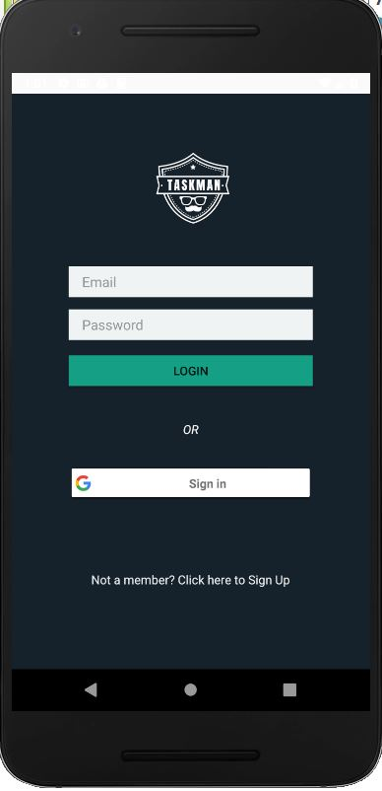
Login Activity
Registered User:
Enter Email Address
Enter Password
Sign in using Gmail
New User:
Register with email

Slide 5
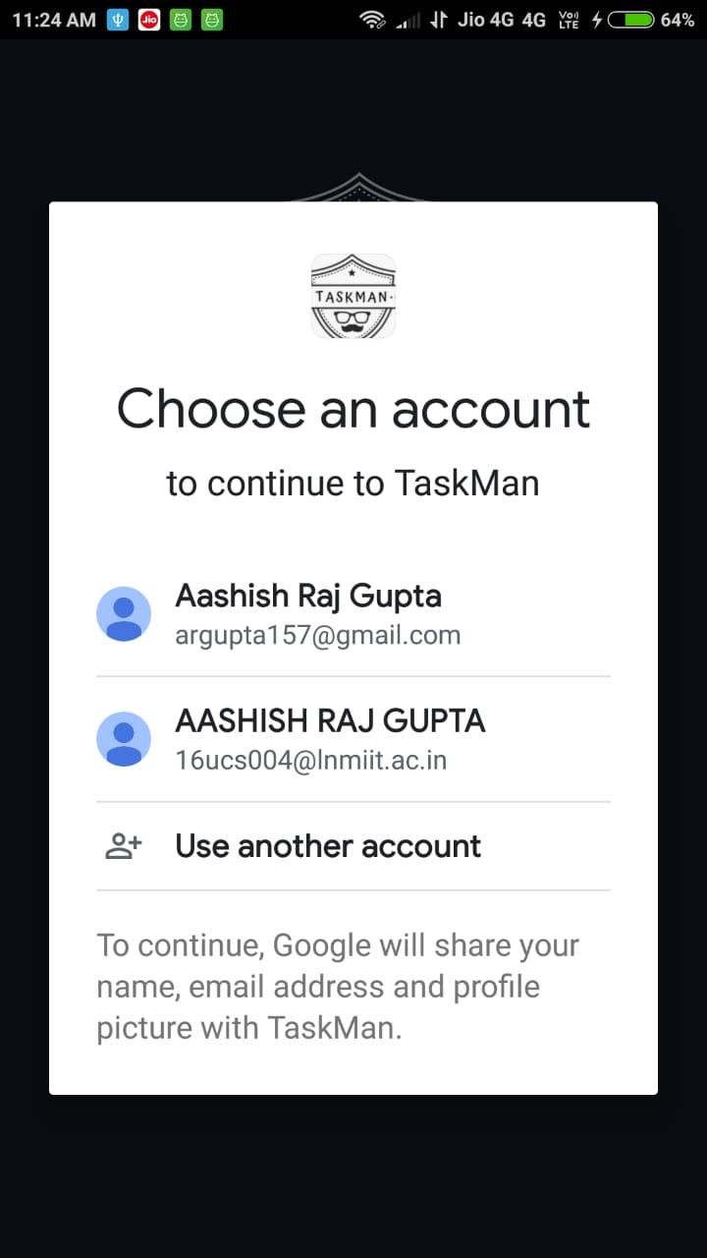
Choose an account pop up

Slide 6
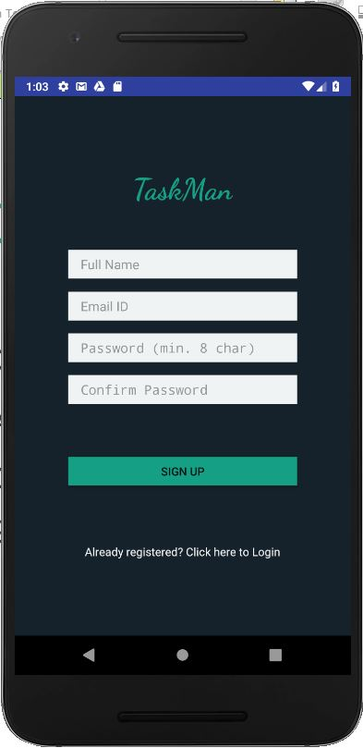
Signup Activity
Create a new account:
Enter UserName
Enter Email Address
Enter Password
Confirm Password

Slide 7
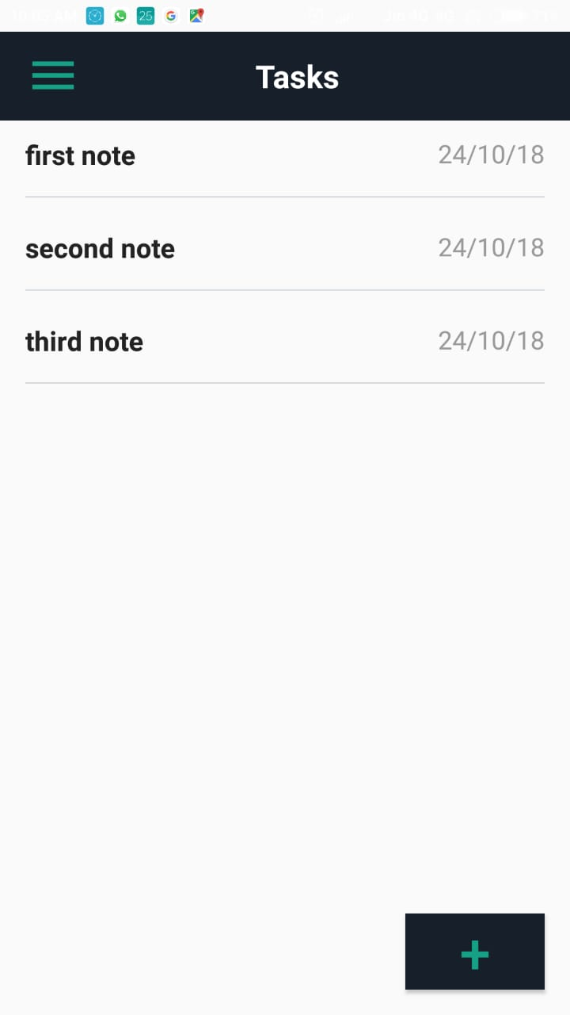
Dashboard Activity
This consists of
All the Notes you have created
Navigation Bar
On swipe delete functionality
On long press share functionality

Slide 8
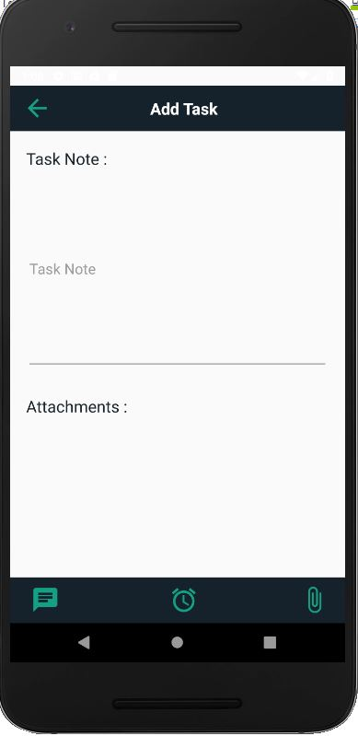
Create Task Activity
To create a new Note enter:
Task description
Other details
Attachment
Images(link will be shown)

Slide 9
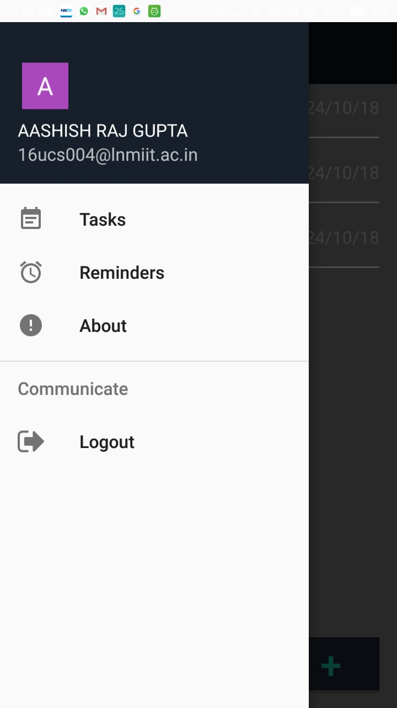
Navigation Bar View
Functionalities
Logout
About

Slide 10
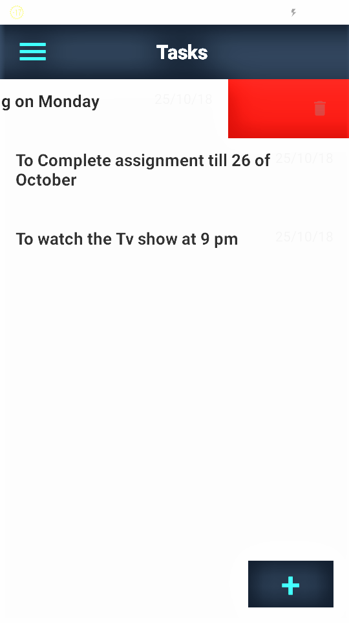

Create Poll Activity
(Step 3)
Delete functionality view
Left swipe delete

Slide 11
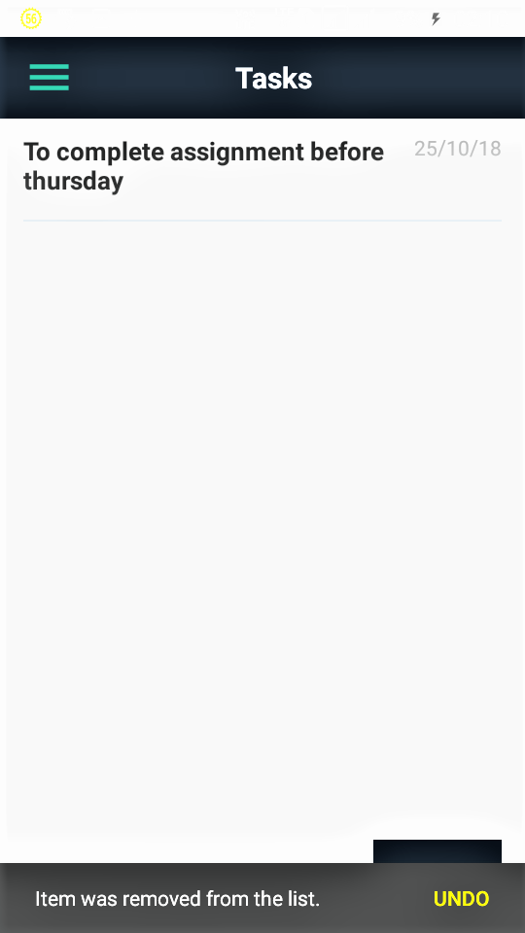

Undo Snackar

Slide 12
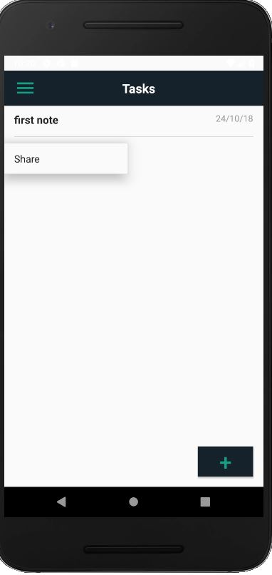
Share functionality
On long press Share pop-up menu will be shown.

Slide 13
2.
Back-end
Server and Database

Slide 14
Security Measures
Password Hashing
Password Hash using Firebase

Slide 15
Database Schemas
Authentication
Email
Password
Username
Task Database
Task
Task ID
Time of Creation
User ID
User Name

Slide 16
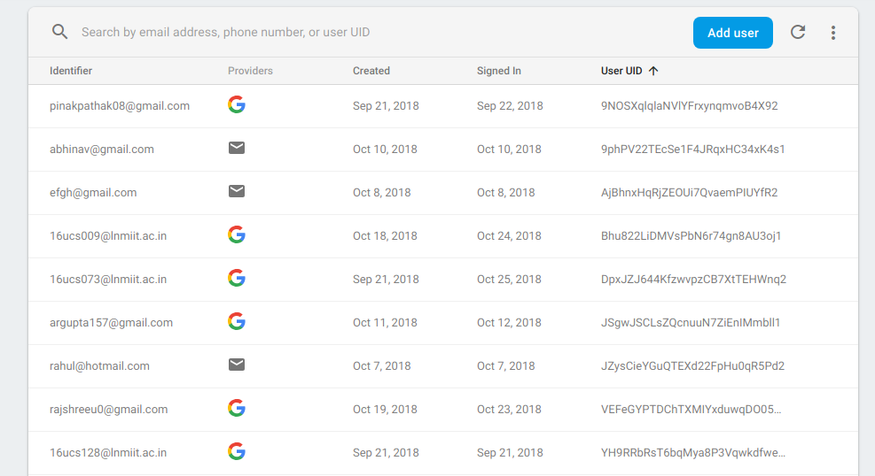

Slide 17
THANKS!!

